Slide 1
SH2AMROCK - The West leading the way in decarbonisation with hydrogen
Professor Rory Monaghan, SH2AMROCK Project Coordinator
University of Galway
Energy West, 3 November 2025

Slide 2
Contents
Hydrogen’s role in decarbonisation
Potential for hydrogen in Ireland
SH2AMROCK hydrogen valley
History
Partners
Objectives
Concept
Closing remarks

Slide 3

First things first…

Slide 4
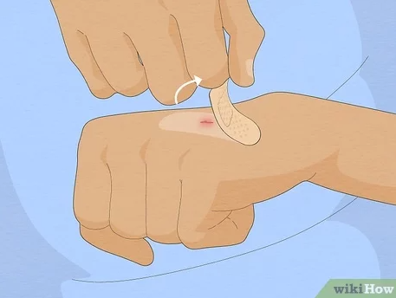
Hydrogen is…
Currently dirty
252 gCO2/kWh for “grey hydrogen” vs 202 gCO2/kWh for natural gas
Currently expensive
€2-15/kg = 60-450 €/MWh vs 27 €/MWh for natural gas vs 120-160 €/MWh for diesel
Always hazardous
It is a high energy combustible fuel
Sometimes inefficient
Electricity → hydrogen = 70% max efficiency
Hydrogen → electricity = 60% max efficiency
Vs >80% for lithium-ion battery
Hard to move
Least dense substance
Readily leaks
So why bother?

Slide 5
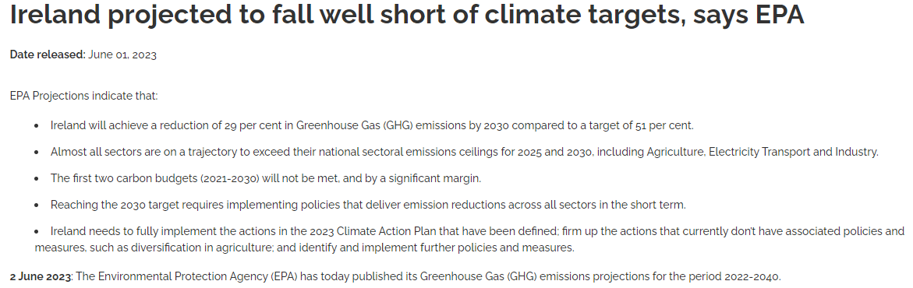

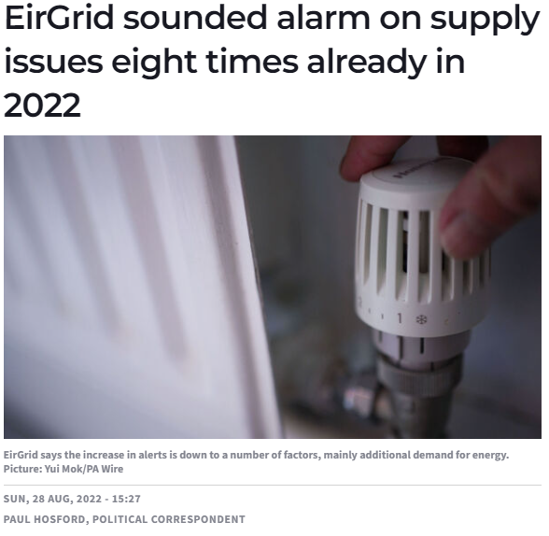
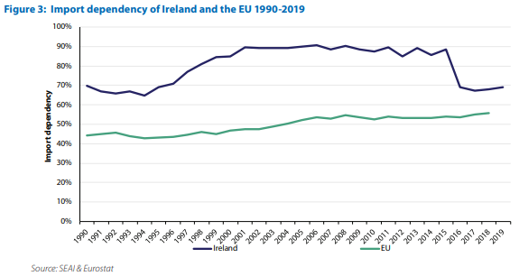
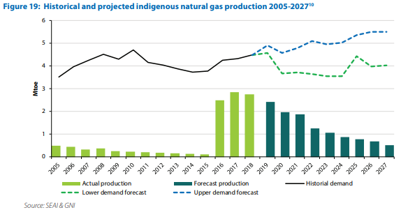
Ireland’s energy system faces challenges

Slide 6
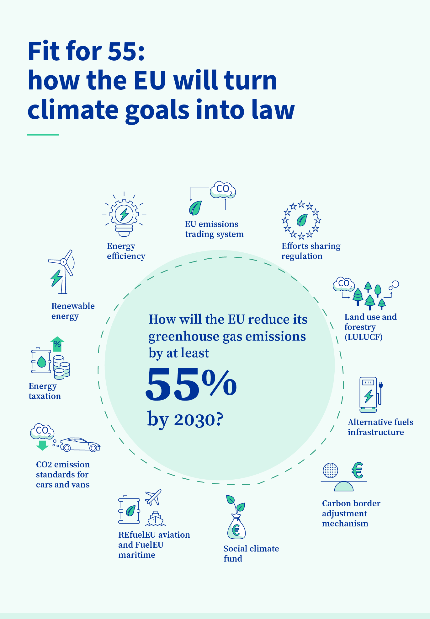
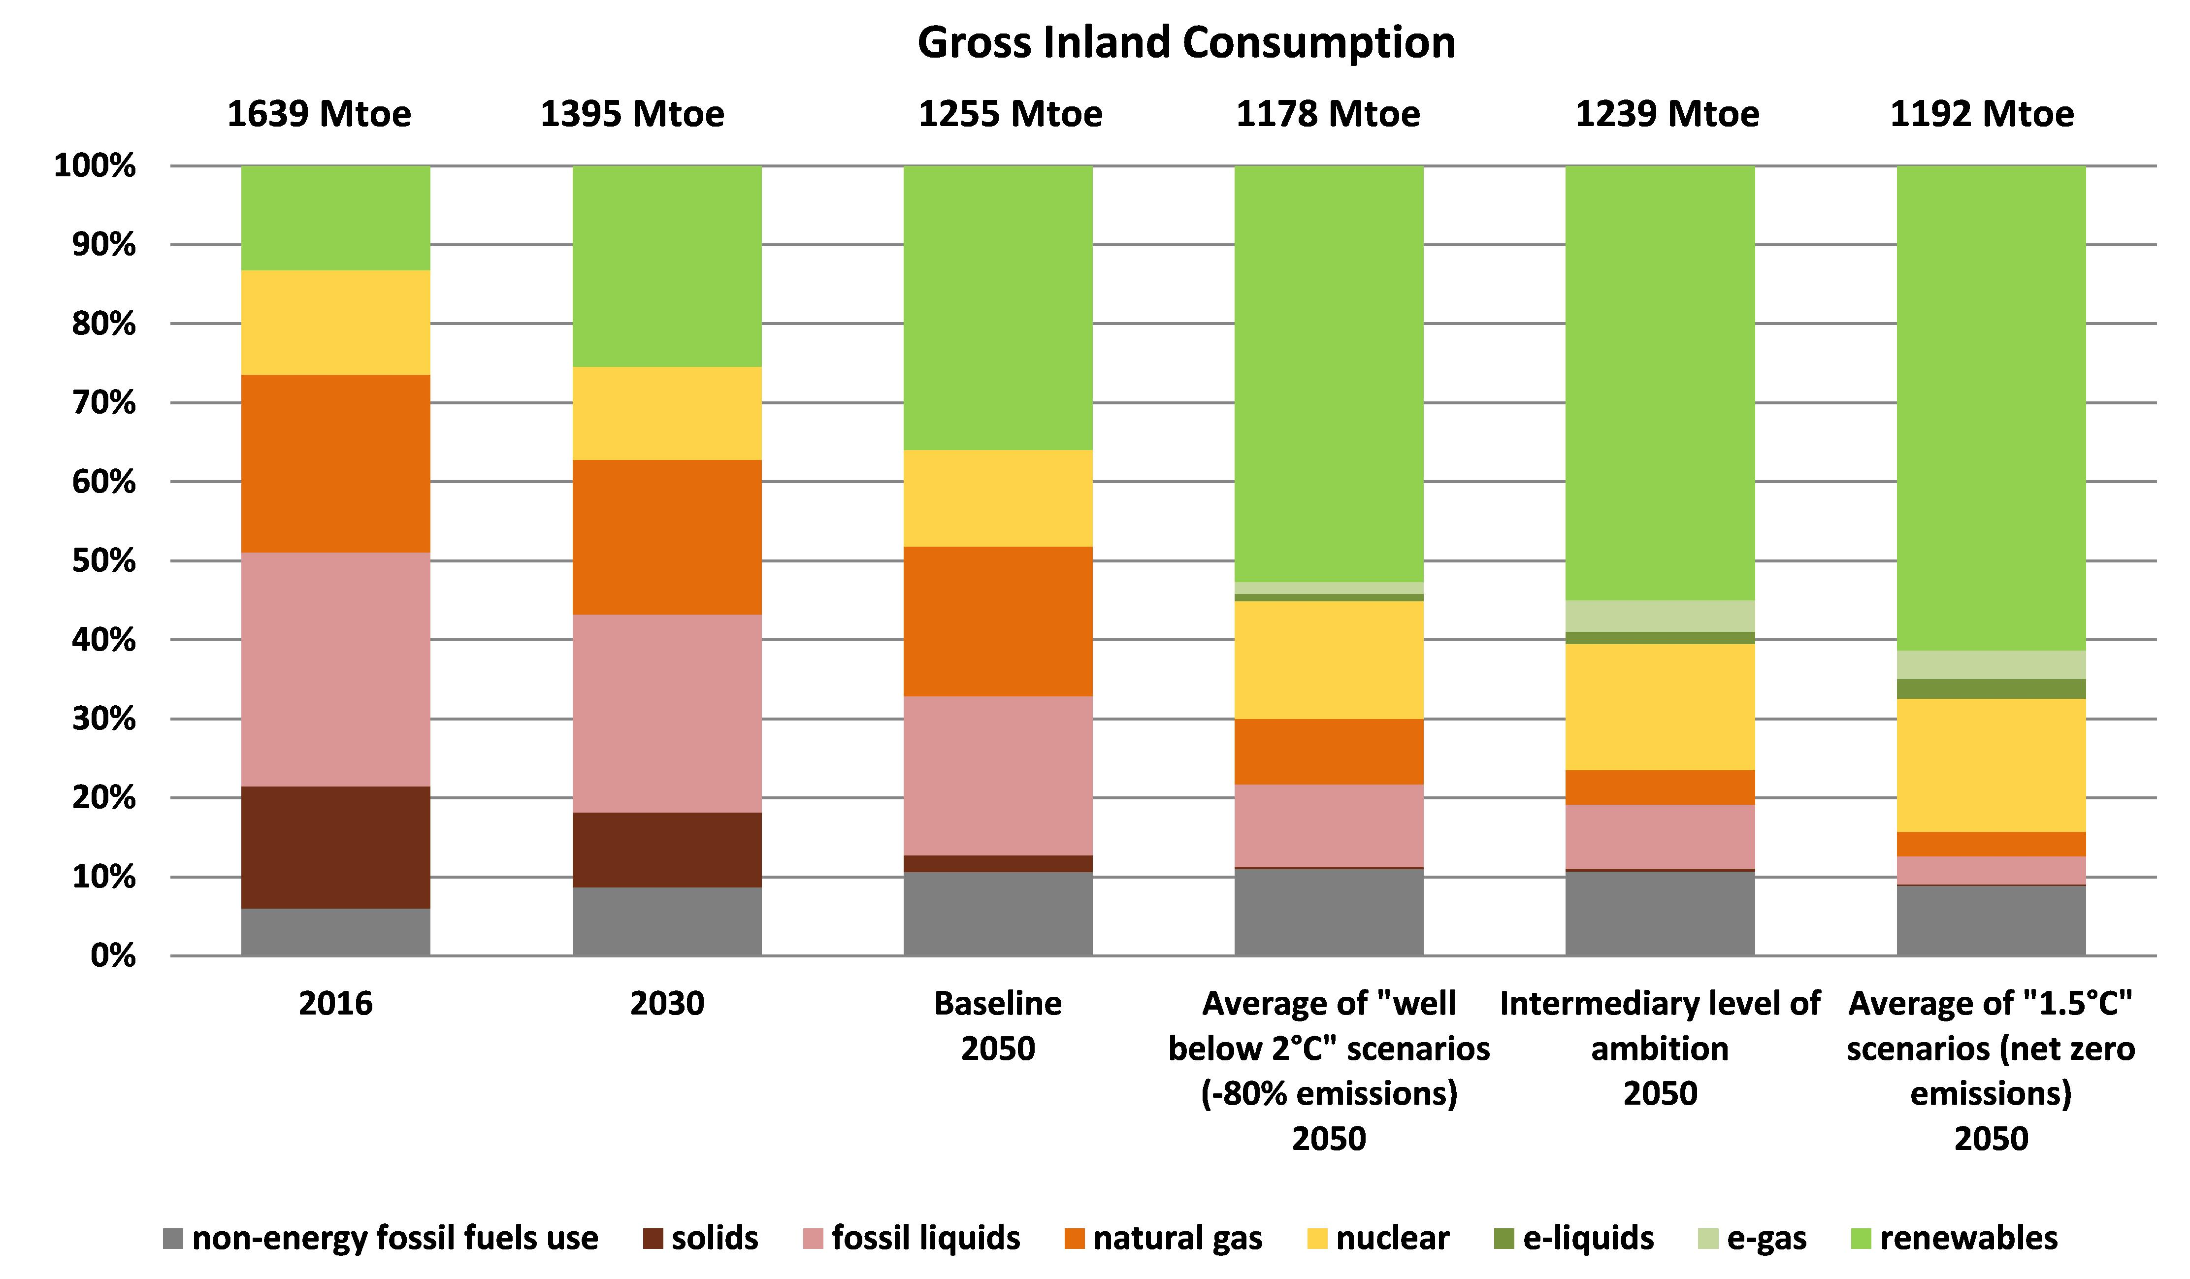
Europe’s energy security and decarbonisation goals
Fit for 55
REPowerEU
Reduce emissions and increase energy security by cutting all Russian gas use well before 2030
Diversify gas suppliers
Use less energy (efficiency, conservation, behaviour change)
Accelerate clean energy (investment, planning)
2050 long-term strategy
Reduce EU’s GHG emissions to “net zero”
Net zero = decarbonise as much as possible, capture excess GHGs from the air

Slide 7
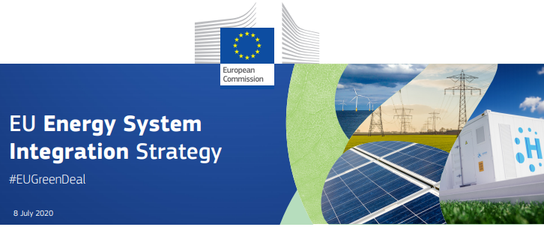
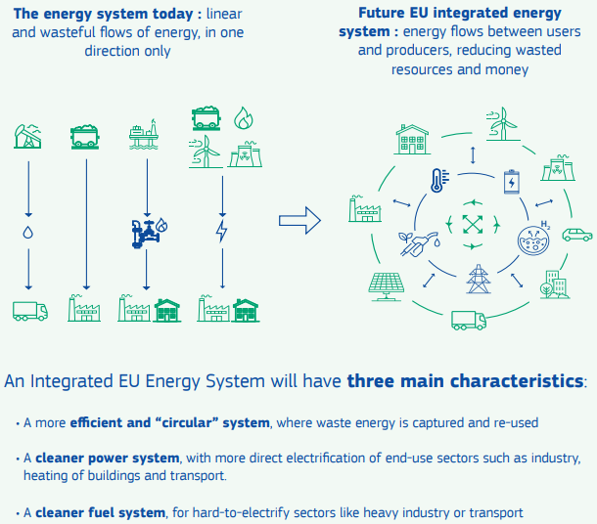
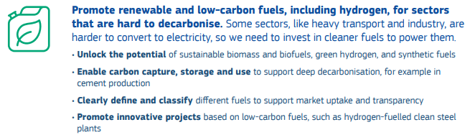
Carbon neutral EU by 2050 Energy system integration
Efficiency
Circularity
Direct renewable electrification
Clean fuels, including hydrogen, for hard-to-abate sectors
https://ec.europa.eu/energy/topics/energy-system-integration/eu-strategy-energy-system-integration_en

Slide 8
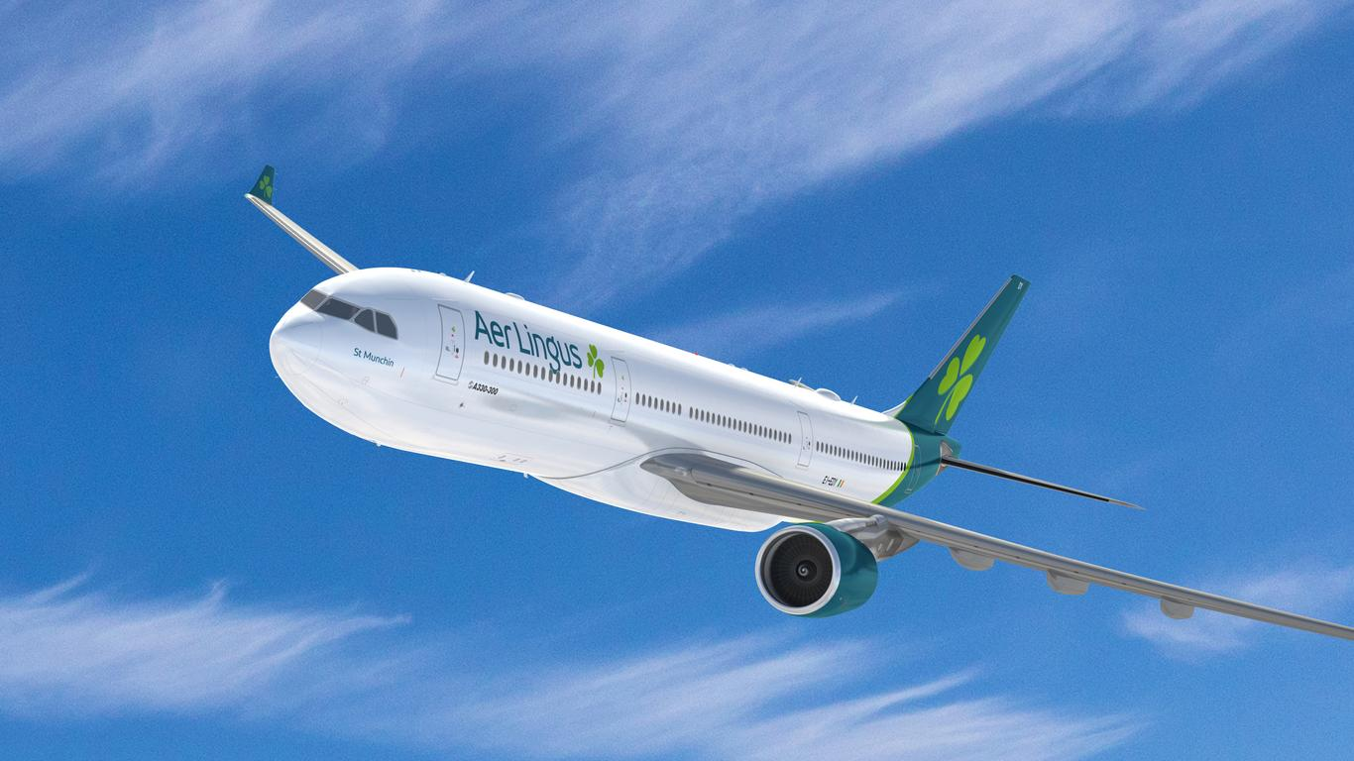
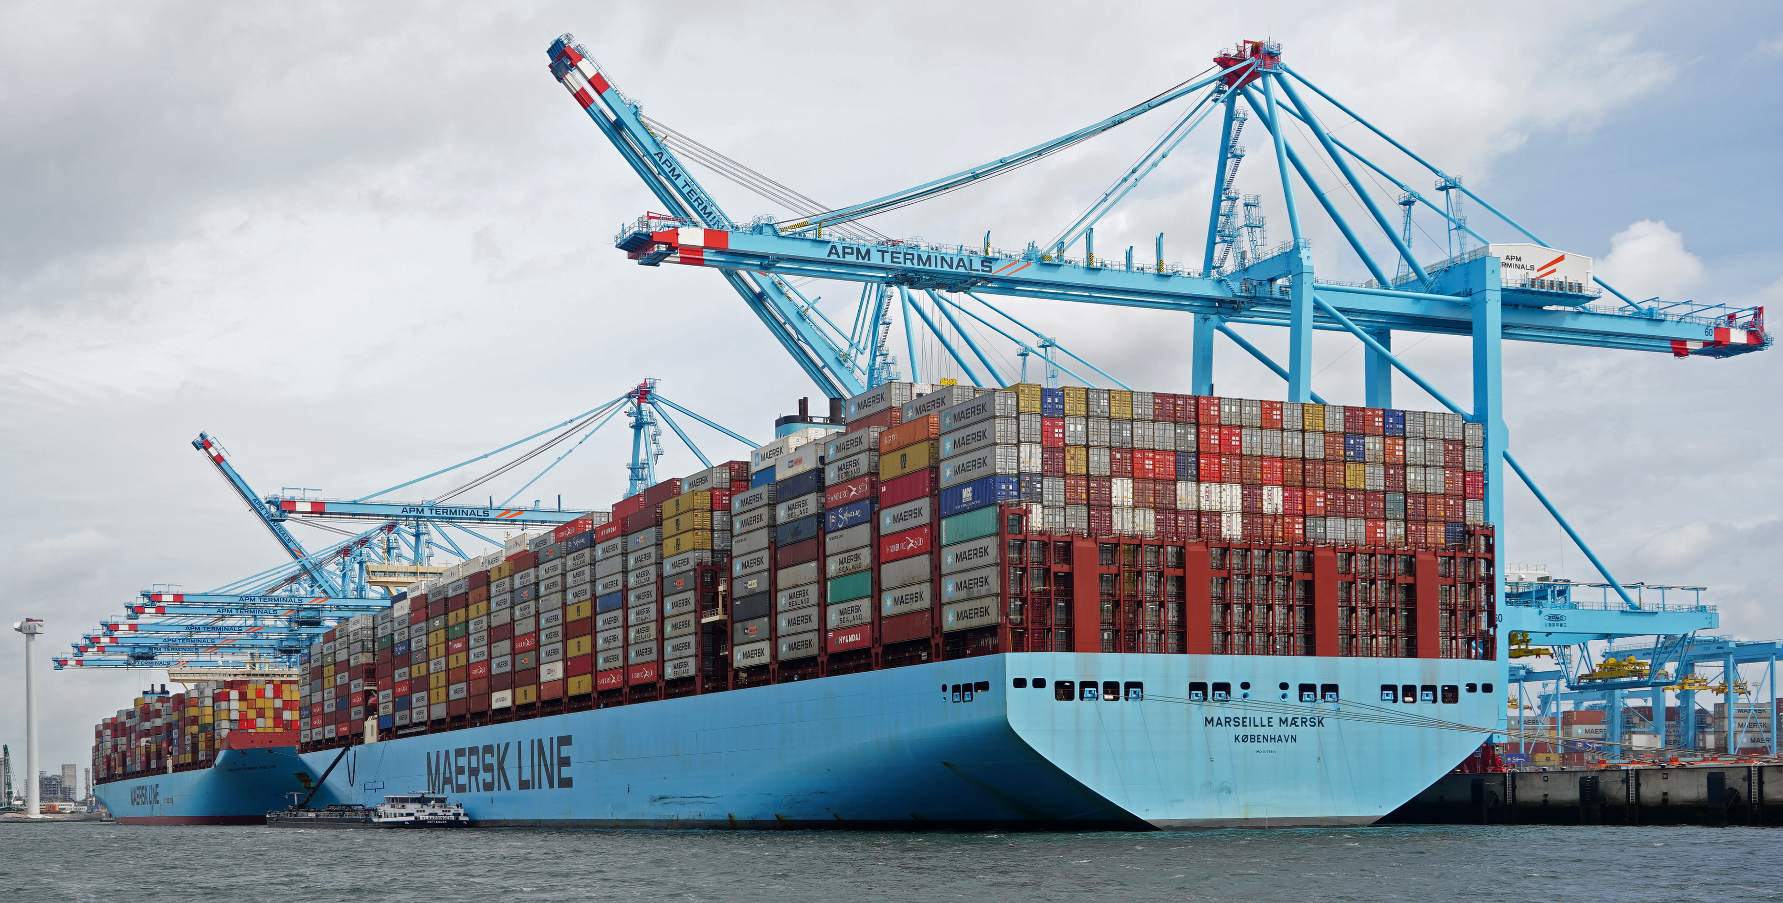
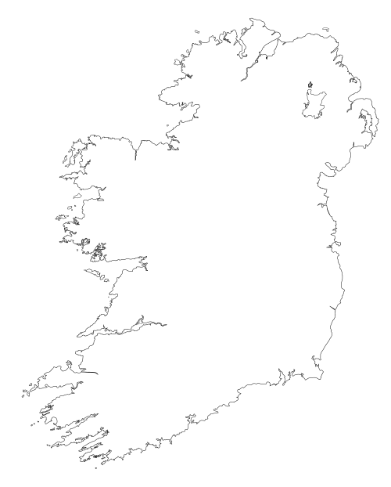
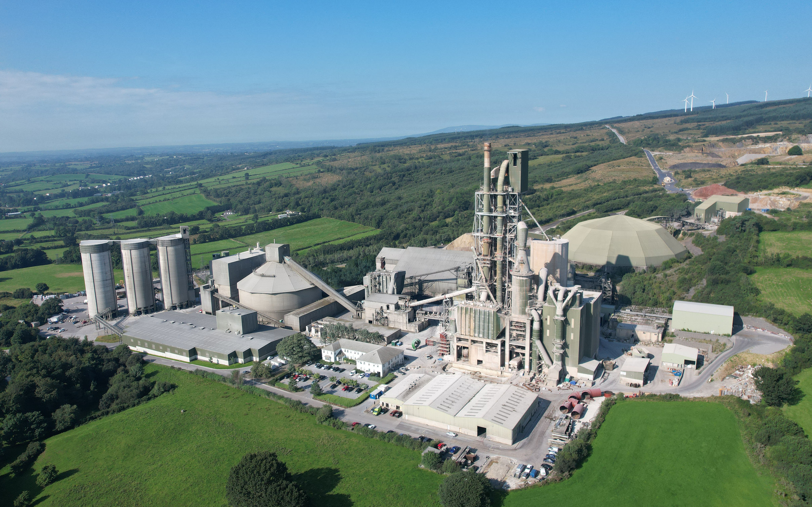
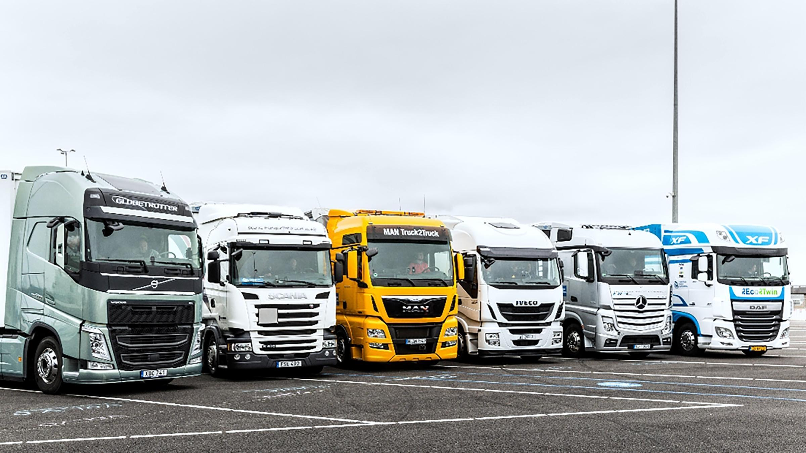
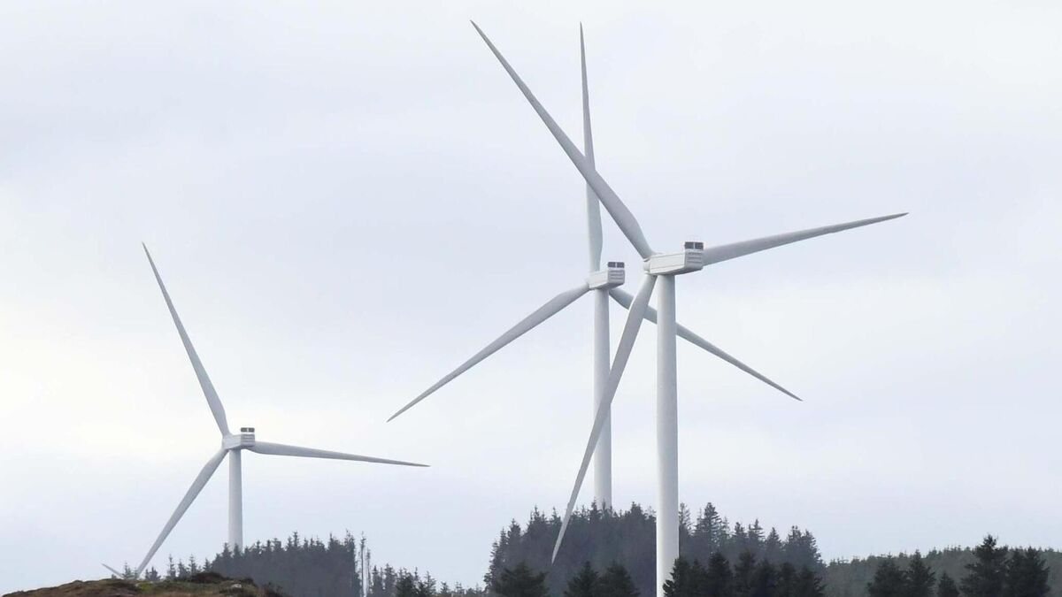

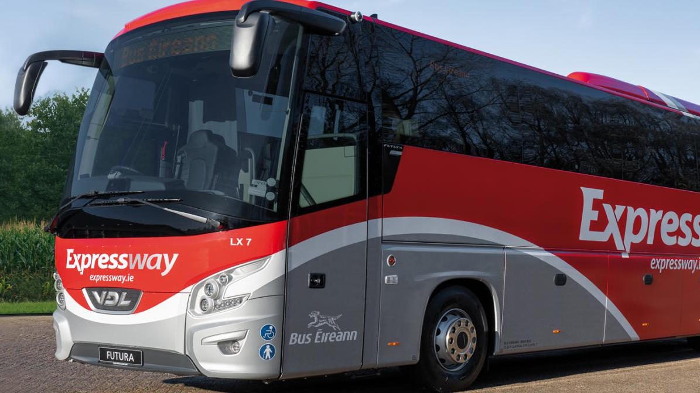
Ireland’s Hard to Decarbonise Sectors
Hydrogen and derivatives can decarbonise these sectors

Slide 9
What additional challenges does a small windy island face?
Energy stored in Turlough Hill PHS
Energy stored in Ireland’s biggest battery ESS
Consistent electricity demand
Variable wind generation

Slide 10
What additional challenges does a small windy island face?
Energy stored in Turlough Hill PHS
Energy stored in Ireland’s biggest battery ESS
Variable wind generation x2
Consistent electricity demand
Variable wind generation

Slide 11
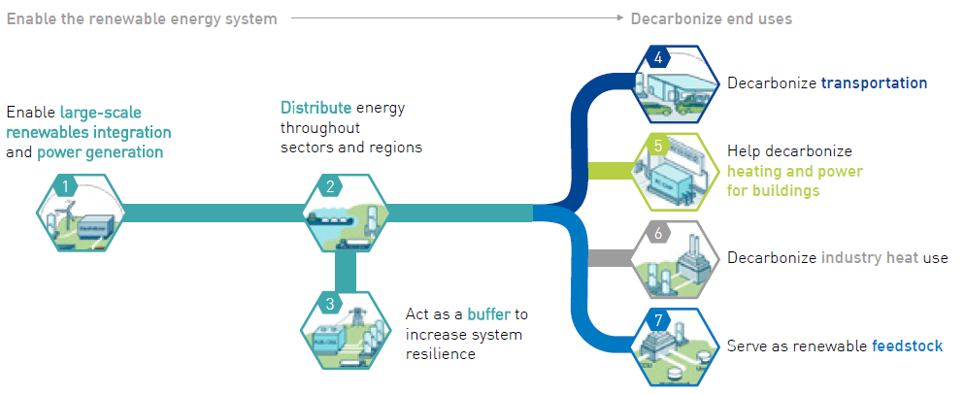
Green hydrogen is a missing link
Image: Hydrogen Roadmap Europe, FCHJU, 2019

Slide 12
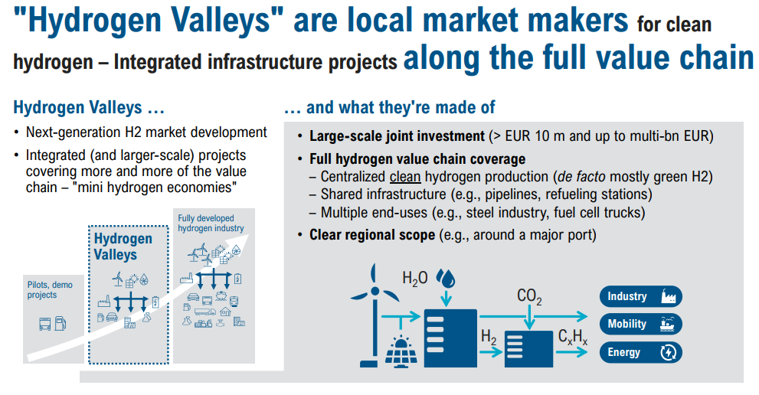
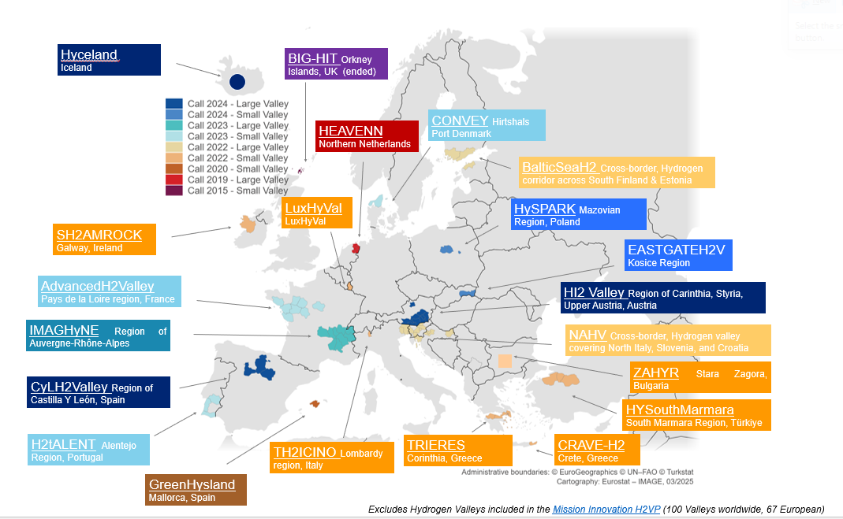
Heavy Transport, Hydrogen and Valleys
Hard to Abate & Import Dependent
EVs can decarbonise and secure light-duty & short haul transport
EU-made hydrogen and synthetic fuels can cover the remainder
Scaling is challenging due to chicken-and-egg

Slide 13



















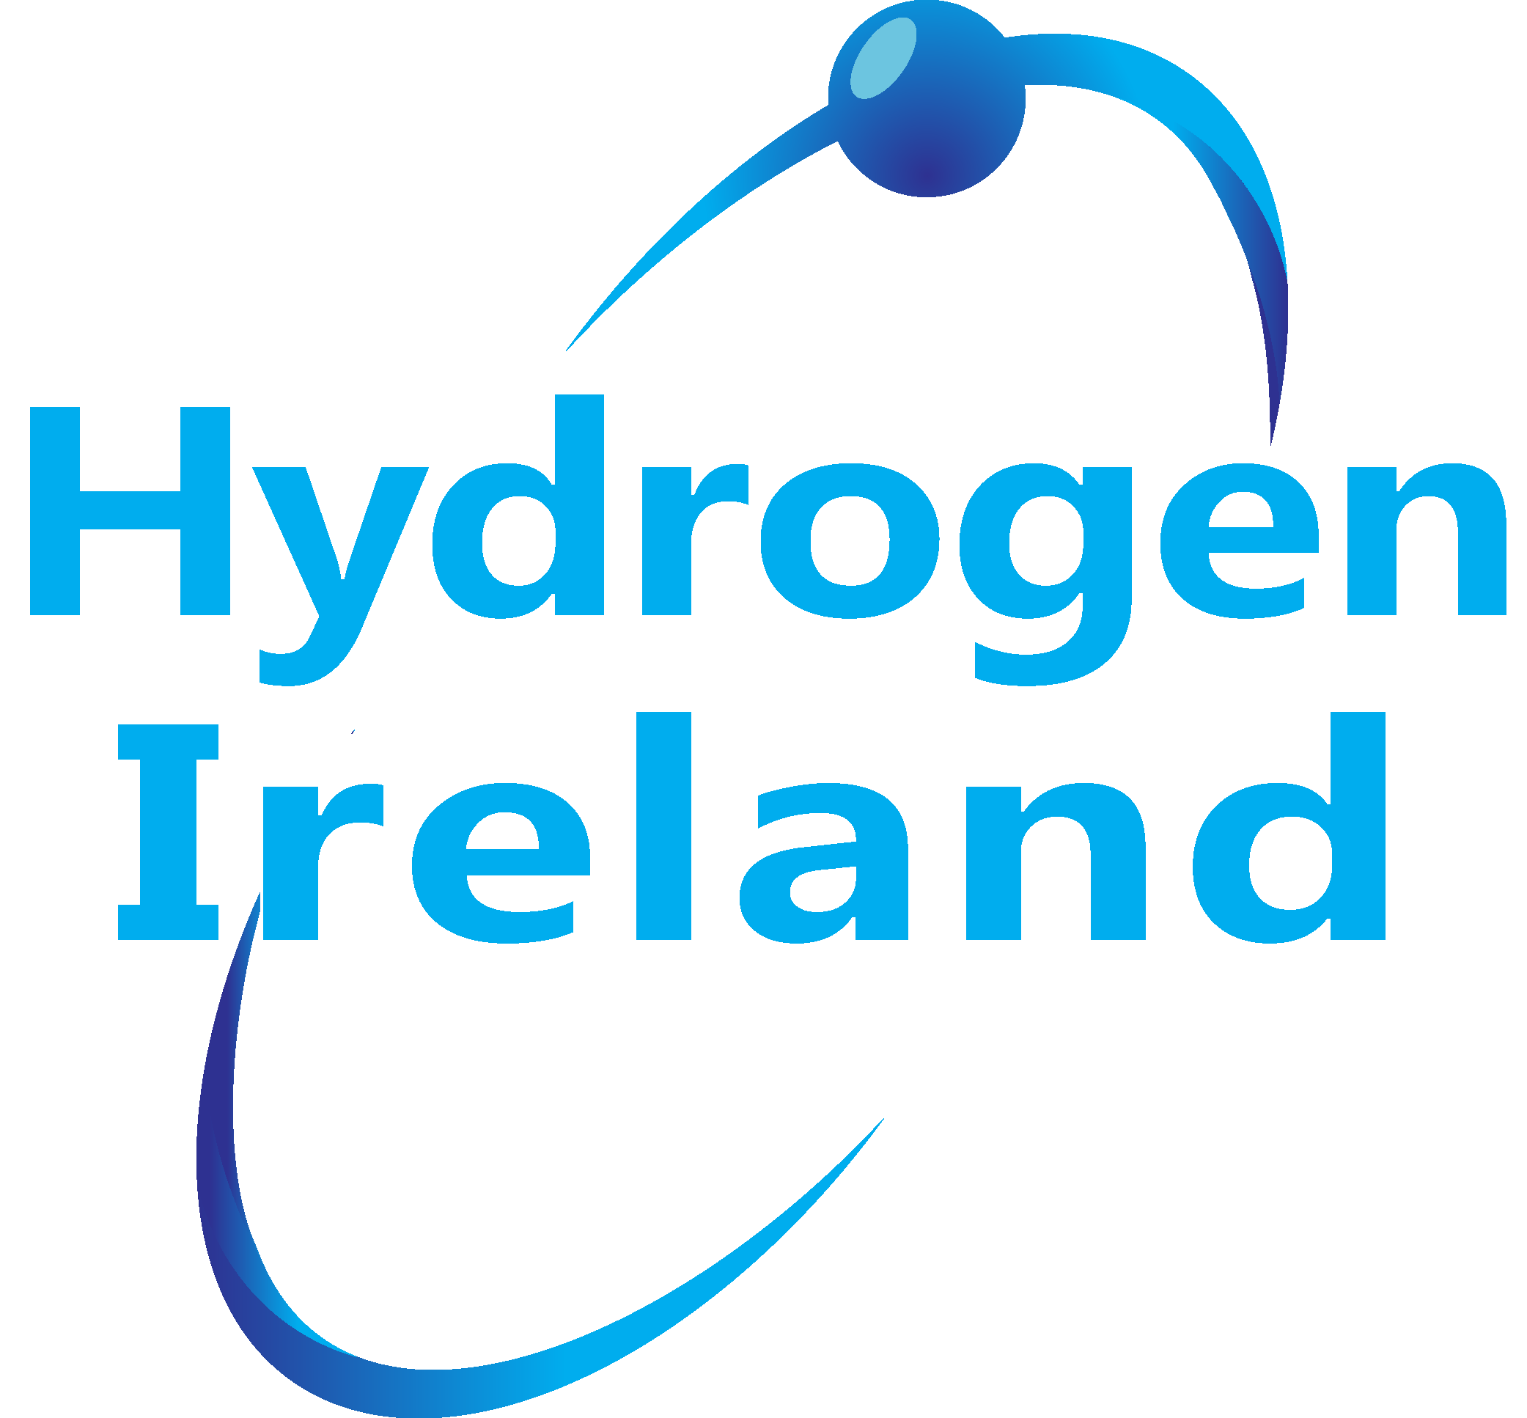


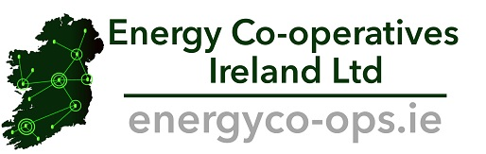















The SH2AMROCK Team
Awarded funding from CHP 2022 call
Initial local hydrogen valley will expand to national coverage
Studies and replication actions for other regions
Project commenced 1 January 2024, 5-year programme
3 years develop & build, 2 years to operate infrastructure and applications
Total project budget €54 million (€8 million from CHP/UKRI)
28 partners from 12 countries
12 Irish partners accounting for €6.2 million at 20-25% funding rate
Coordinating partner
Deployment partners – delivering infrastructure in Ireland
Dissemination and replication partners – expanding knowledge globally

Slide 14
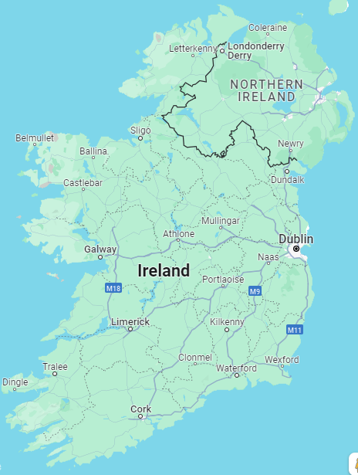
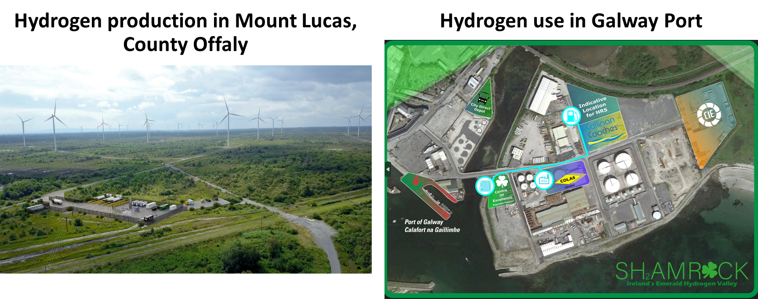








The SH2AMROCK Project
Deployment of:
Up to a 4-MW electrolyser
At least 500 tonnes per year
3 tube trailers
1 hydrogen refuelling station
3 double deck buses
10 intercity coaches
5 logistics trucks
4 vans/minibuses
Bitumen plant decarbonisation
Hydrogen aircraft demonstration
Studies:
Project sustainability impact
Project H2 market analysis
H2 business models
Decision tool for BEV-H2 fleet TCO
Scale-up beyond project
Regulatory barriers & opportunities
H2 roadmaps for Galway & Ireland
Replication studies in
Other end users

Slide 15
SH2AMROCK Reflections
Hydrogen transport & dispensing
Hydrogen production & compression
Our successes
Stakeholder engagement leading to planning consent for H2 production
Partners are learning about H2 as a team
Strong and open communications with policymakers
Current status
Tackling the “electrify everything” mindset
Seeking additional sources of project funding
Seeking implementation of Ireland’s National Hydrogen Strategy
Working with suppliers to secure H2 vehicles for the “wrong side” of the road
Aligning H2 supply and offtake timelines
P1
P2
P2
P4
P5
P6
Project concept developed
Feasibility study ongoing
Pre-FID development
Post-FID development
Under construction
In operation
Hydrogen end users
The next steps
Delivery is essential for the next 12 months
Design and permitting of refuelling station and industrial application will be advanced
Scale-up and replication studies will be commenced
Align with HYDEA hydrogen in ports project
SH2AMROCK aims to
Crack the chicken-and-egg problem and unlock green hydrogen supply across Ireland
Serve as the template for the rollout of Ireland’s AFIR-compliant hydrogen refuelling station network
Spur the development of other hydrogen valleys in Ireland and beyond

Slide 16
SH2AMROCK - The West leading the way in decarbonisation with hydrogen
Professor Rory Monaghan, SH2AMROCK Project Coordinator
University of Galway
Energy West, 3 November 2025

Slide 17
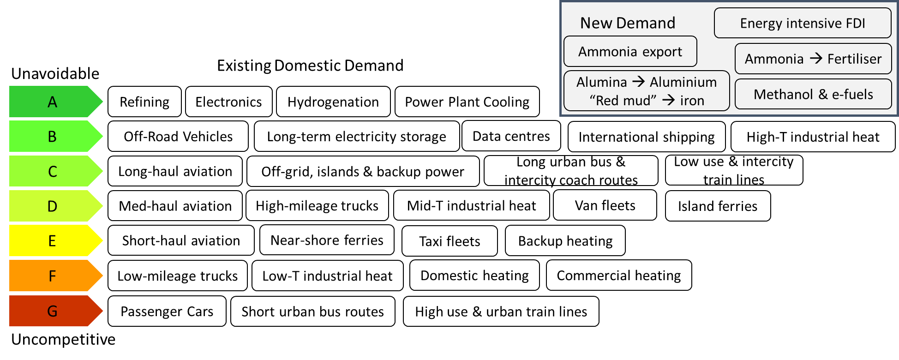
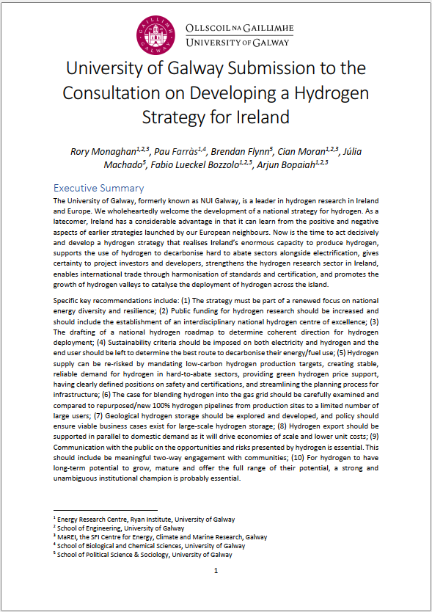
What are Ireland’s Hard to Decarbonise Sectors?
A possible “Liebreich Ladder” for hydrogen in Ireland
Source: UG submission to Nat’l H2 Strategy, link

Slide 18
Getting back to our small windy island
1,800-MWh pumped hydro plant
200-MWh lithium-ion battery plant
Variable wind generation x2
Consistent electricity demand
Variable wind generation

Slide 19
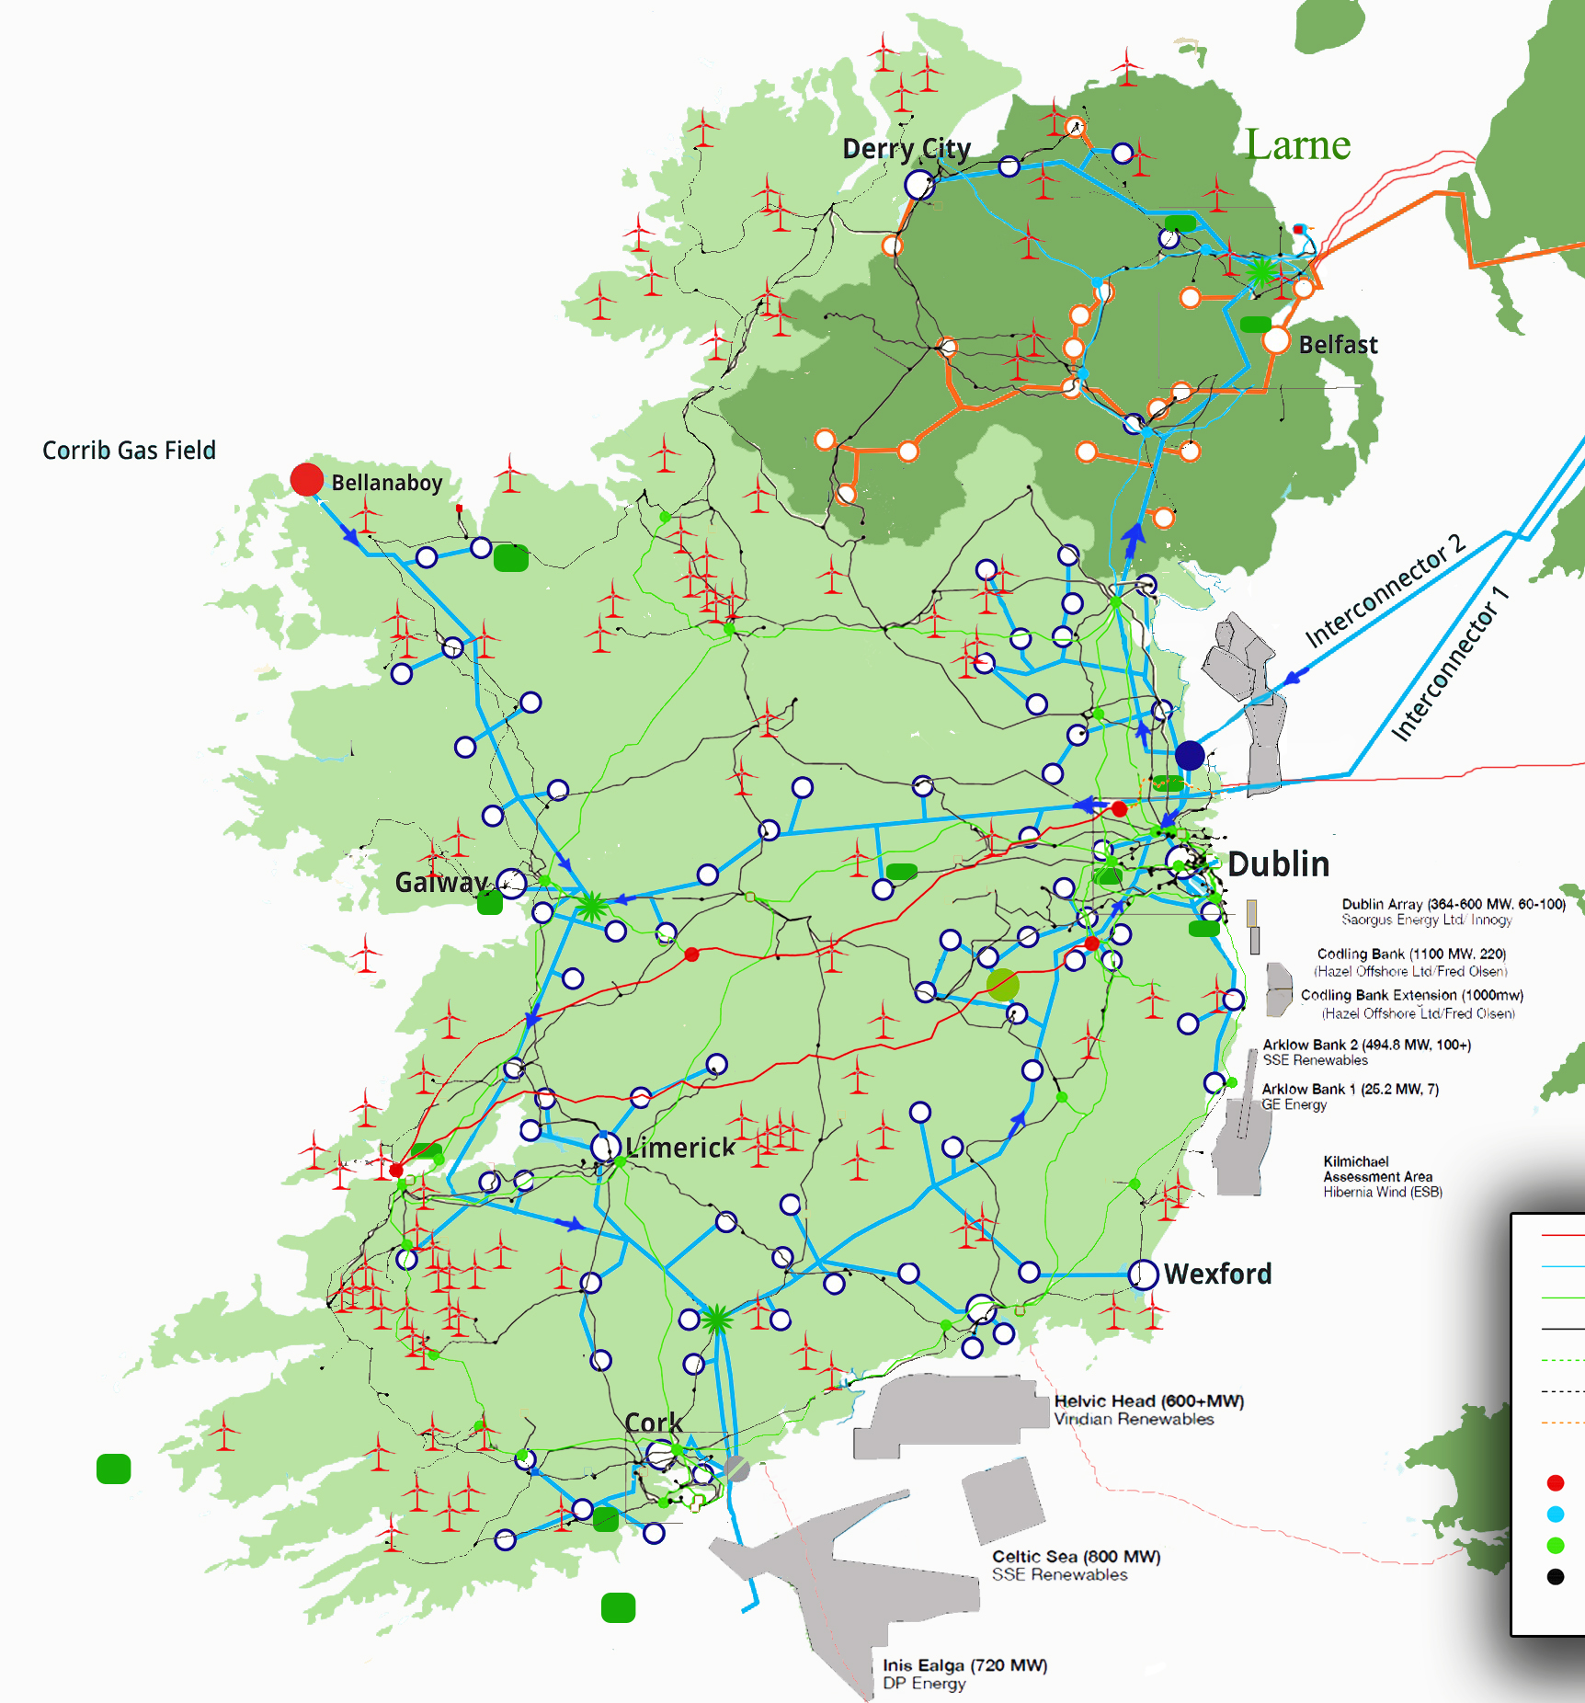
Green hydrogen could support the energy transition
Potential multi-TWh hydrogen storage in a Northern Ireland salt cavern
1,800-MWh pumped hydro plant
200-MWh lithium-ion battery plant
Variable wind generation x2
Consistent electricity demand
Variable wind generation

